Slide 1
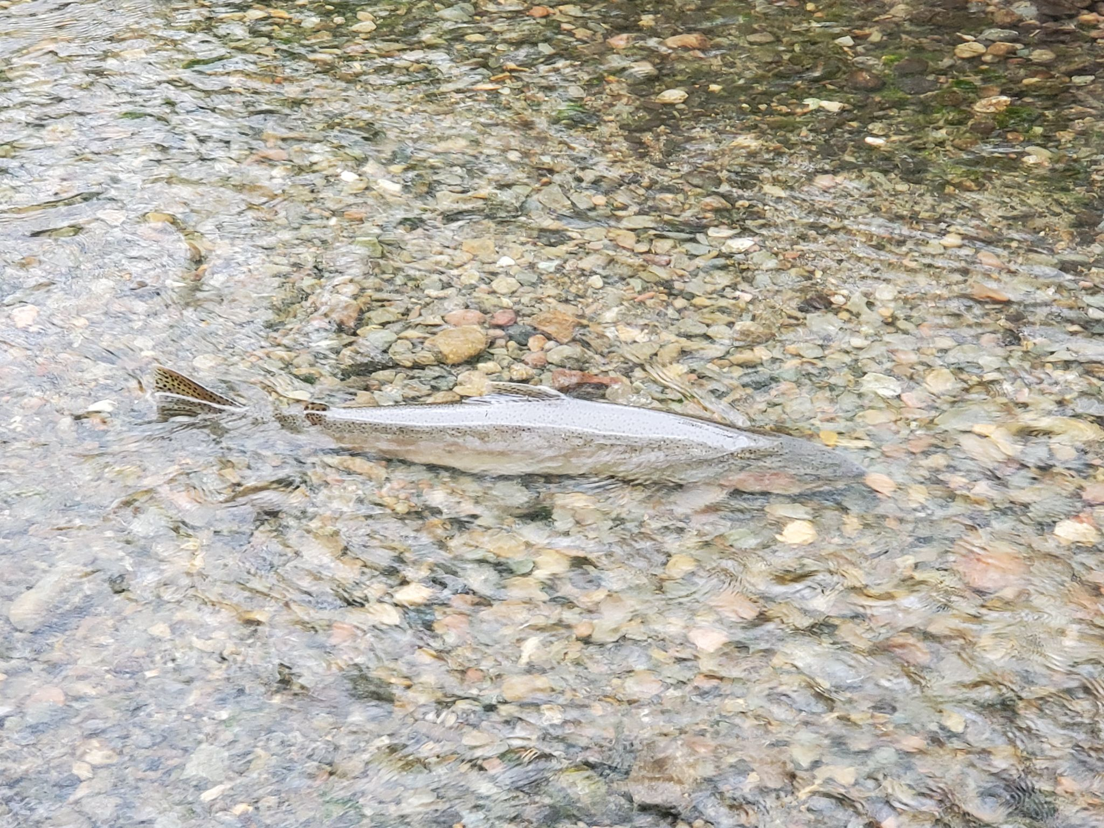
California Salmonids and Protected Areas
Adelaide Robinson

Slide 2
Background and Motivation
Many populations of anadromous* pacific salmon are expected to go extinct within the next 100 years
Most steelhead and all coho populations within California are federally listed
Habitat loss and urban land use are linked with their decline and lowered juvenile survival
* Anadromous fish are born in freshwater, migrate to the ocean and return to freshwater to reproduce

Slide 3
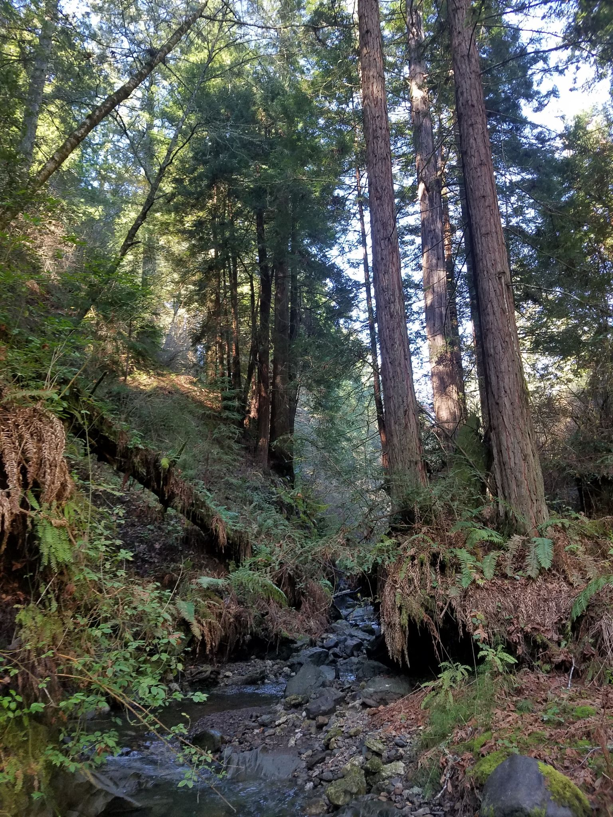
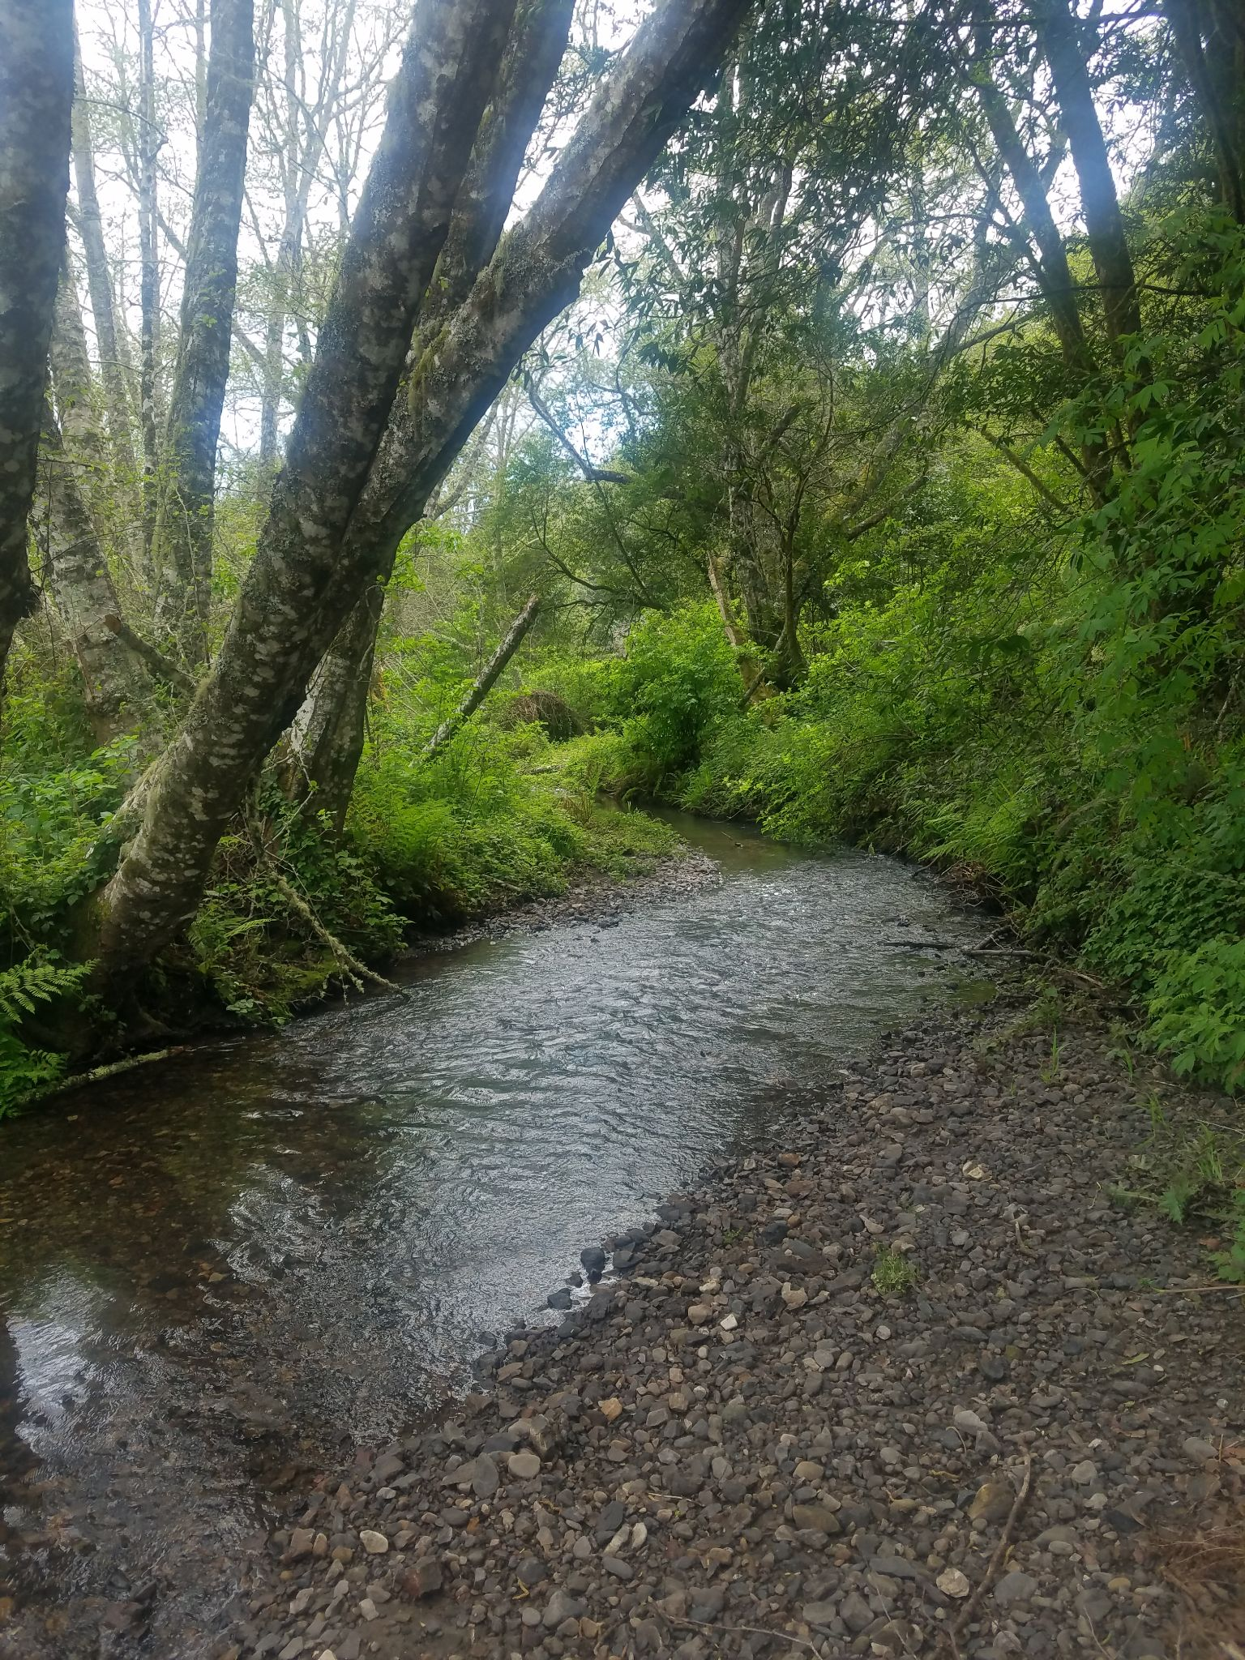
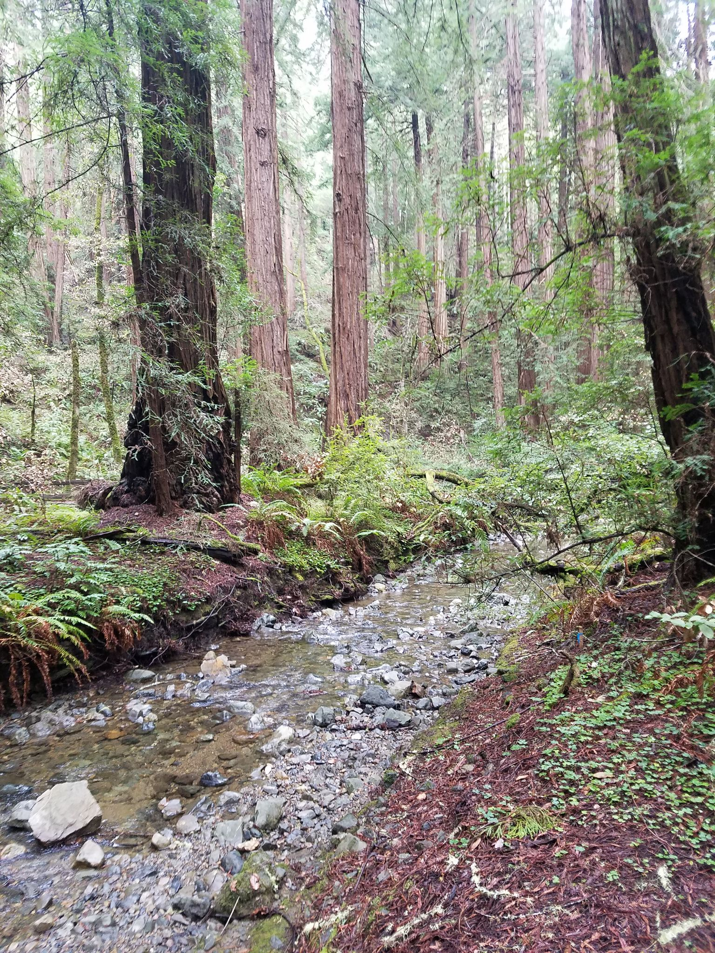
Question
How do protected freshwater areas impact CA coho salmon and steelhead populations?

Slide 4
Data
California Monitoring Plan for Salmon and Steelhead
Monitor and assemble data on anadromous salmon populations across California
Adult population estimates for coho and steelhead, collected yearly within each watershed
Geospatial data on the extent of monitored watersheds
CDFW and NOAA
California Protected Area Database
Geospatial data on areas protected across CA
Combined to calculate percent of watershed protected along with adult population estimates for each

Slide 5
Analysis
PopulationEstimate_{i} = 𝛃₀ + 𝛃₁year_{i} +𝛃₂ %Protected_{i} + 𝛃₃year_{i}*%Protected_{i} + E_{i}
OLS linear regression
Multiple Regression: Population estimate regressed on percent protected and year
Interaction: Percent protected and year
The slope of the relationship between year and population count can vary based on %protected.
H₀ = 𝛃₁ = 𝛃₂ = 𝛃₃= 0
H_{A} ≠𝛃₁≠𝛃₂ ≠𝛃₃≠0

Slide 6
Steelhead Results
Increase in percent protected is related to an increase steelhead, but it decreases the slope of change in populations over time
Steelhead increase as year increases
Coefficients are not significant using a significance level of 0.05
Term | Estimate | p.value | Confidence Interval
Intercept | 218. | 0.216 | -128. to 564.
percent_protected | 4.23 | 0.207 | -2.35 to 10.8
year | 52.3 | 0.116 | -13.0 to 118
percent_protected:year | -0.986 | 0.113 | -2.21 to 0.236

Slide 7
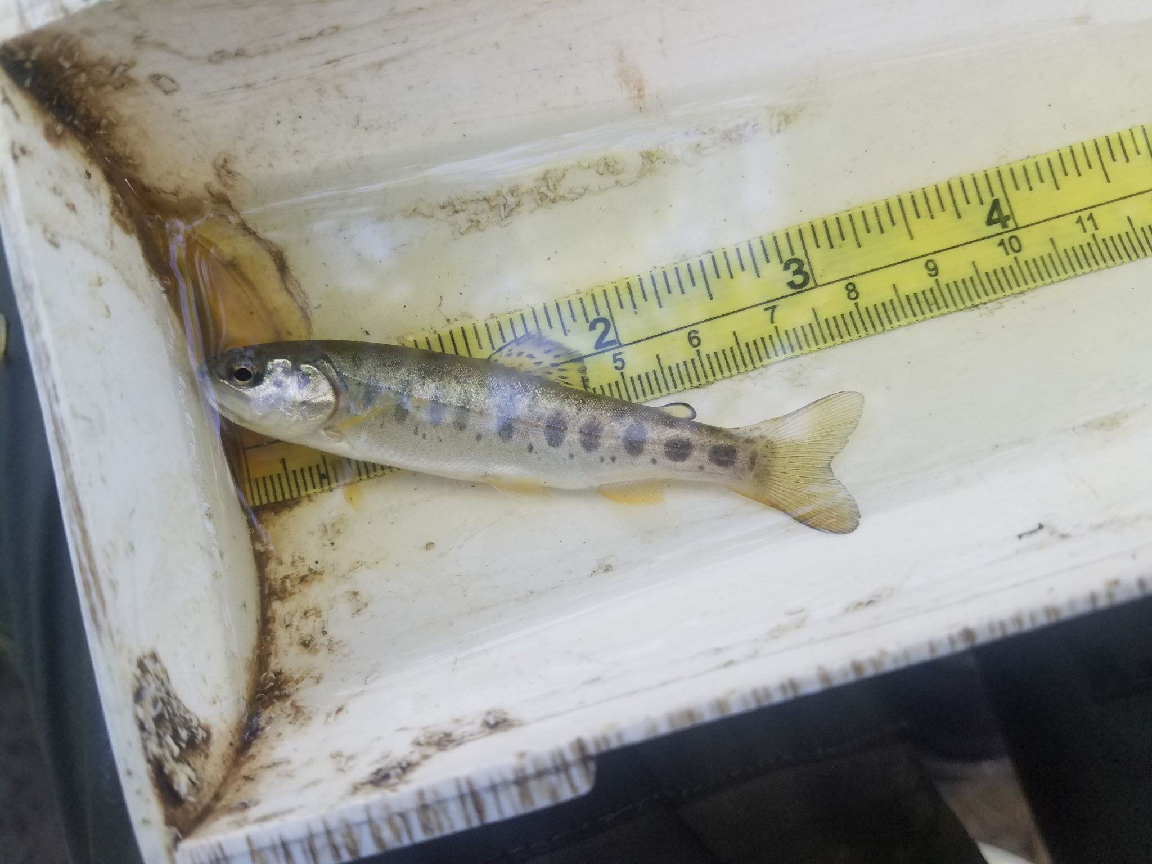
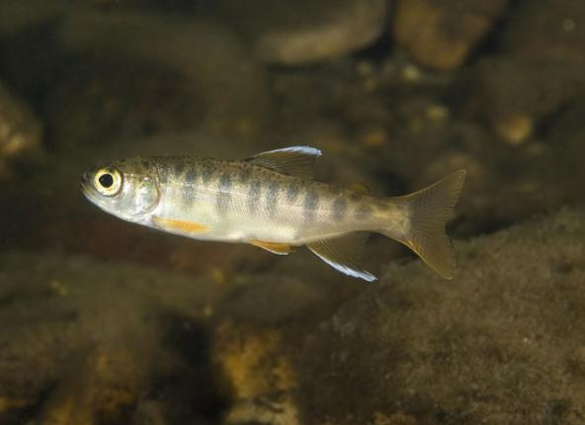
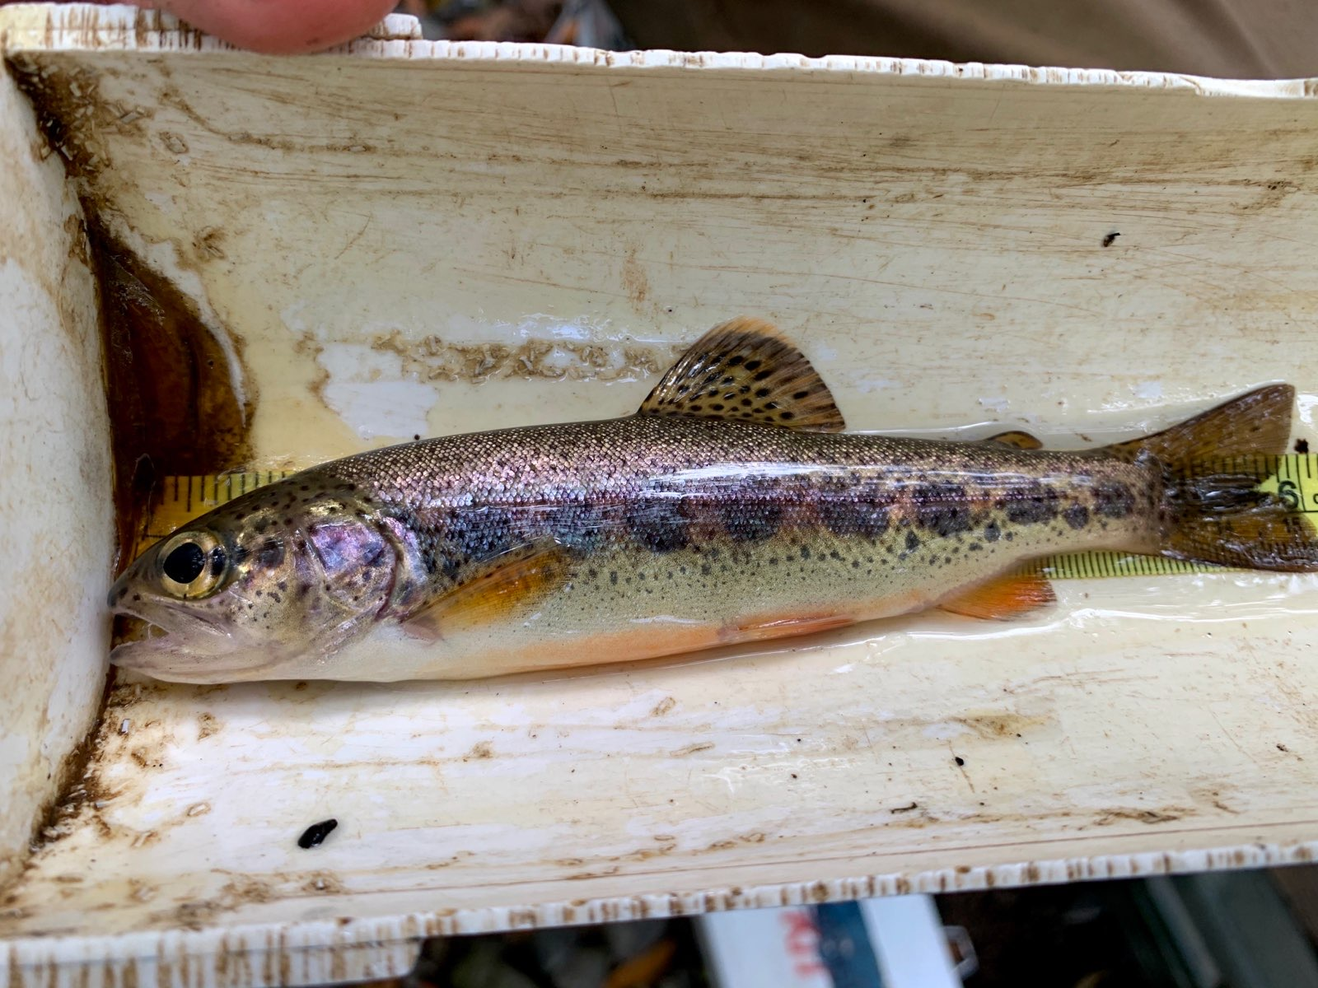
Takeaways and Next Steps
I fail to reject the null hypothesis at a significance level of 0.05
Explore the relationship between protected areas and survival in a different way
Isolate impact of protected areas by looking at juvenile overwinter survival rate
Photo by NOAA

